Slide 1
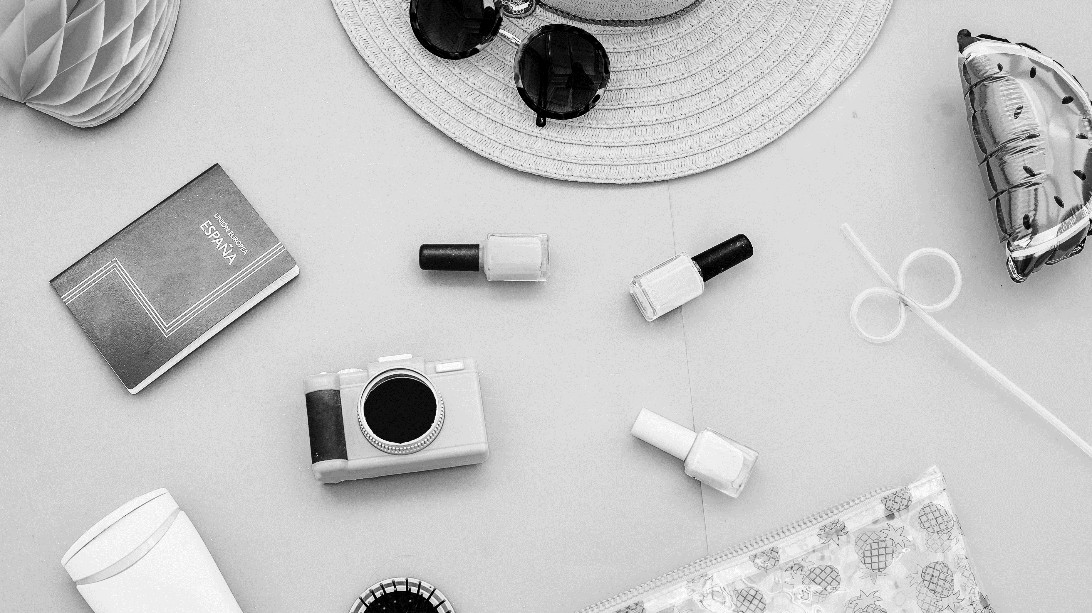
1. Right Click -> Format Picture -> Picture Options -> Picture Color -> Saturation 0%
2. Effects -> Artistic Effects -> Add a strong blur
3. Reduce Picture sharpness

Slide 2
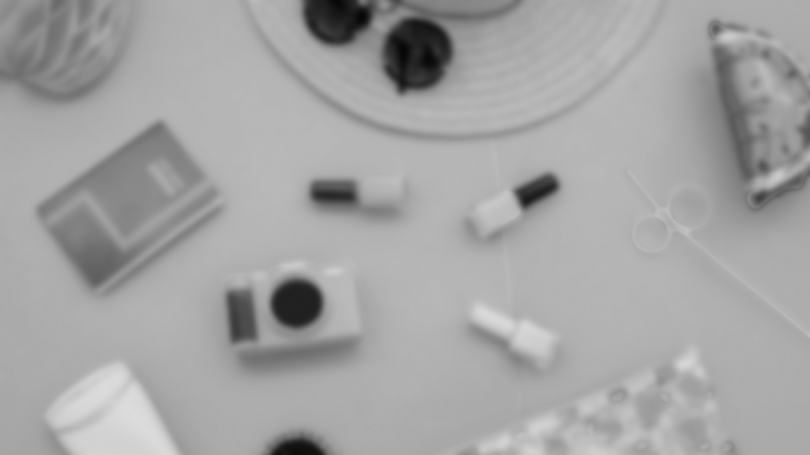

Slide 3

1. Insert a rectangle. Increase its transparency
2. Make a gradient overlay
3. Make a „half” overlay

Slide 5

If you decide for Inkscape
1. File -> Document Properties -> 1920x1080 and set to px
2. Path -> Object to path
3. Add or draw a rectangle. Add nodes by double-clicking
Welcome

Slide 6
Welcome

Slide 7
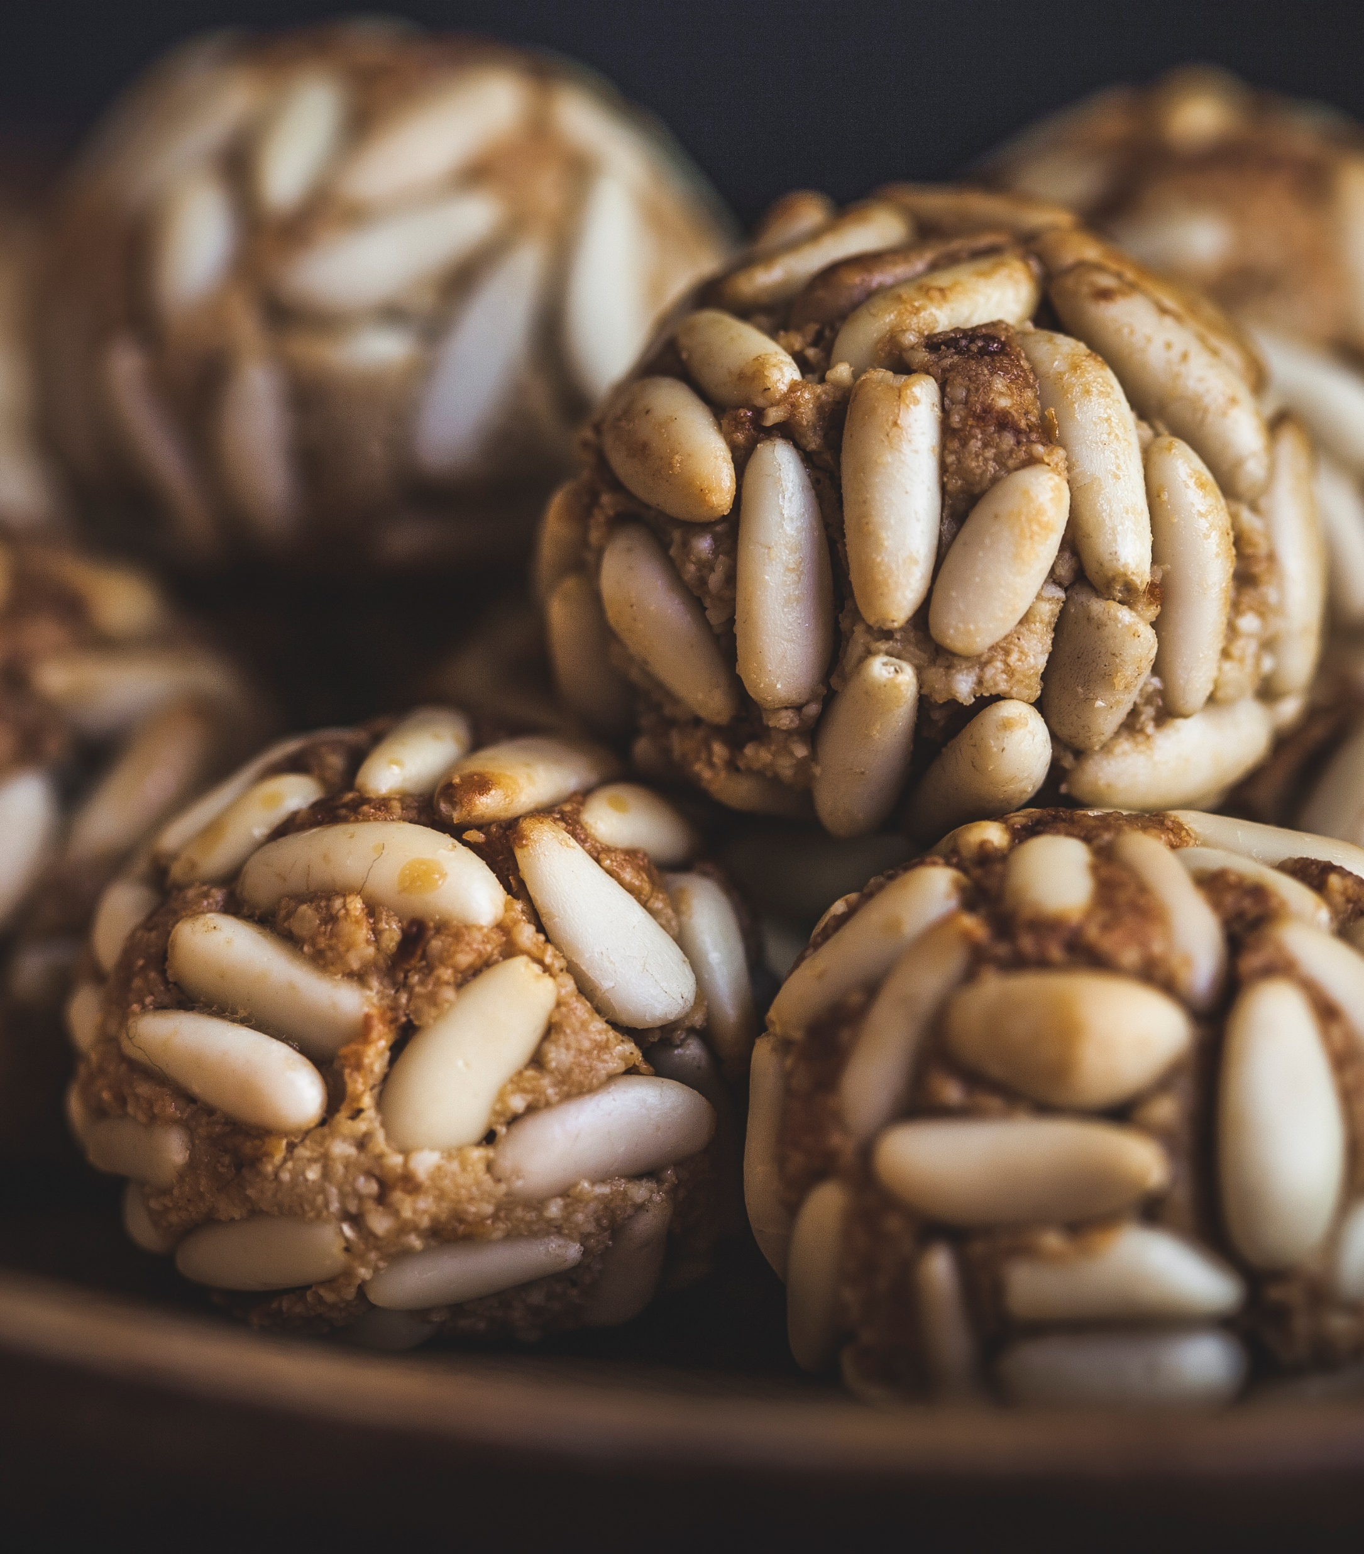

Nice slide

Slide 8
1. Draw a triangle using the Stars & Polygons icon on the toolbar (3 corners)
Option 1 – Adjust the roundness
Option 2 – Path -> Path Effects -> Corners

Slide 10


Slide 11


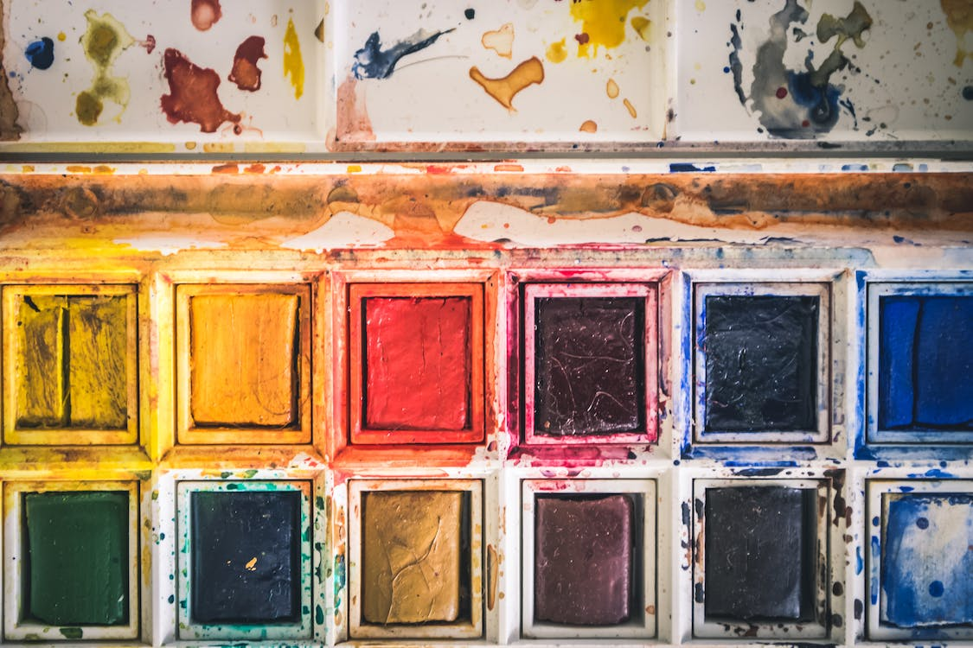

SVGrepo
UnDraw
Pexels
Unsplash

